Slide 1
Travel & Expenses in MyClark
Sabra Sand, Director of Business

Slide 2
Definitions
  Travel and Expense is completed in the Finance pillar in MyClark.
  The name of the module is Expenses, abbreviated EX
  Travel & Expense, abbreviated T&E, is what most of the processes and functionality within the Expenses module applies to and is how Expenses pages are organized in the PeopleSoft menu navigation structure
  For MyClark we tend to use “Travel & Expense” more often because it better describes what we use the Expenses module for, but “Expenses” may still be used when referencing the module specifically

Slide 3
There are three types of T&E documents we use:
  Travel Authorization (TA) – Travel document created prior to travel showing estimates costs for travel; produces an encumbrance that will get relieved once an Expense Report is filed against it
  Cash Advance (CA) – Travel document created to facilitate payment to the traveler in advance of travel; can be applied across multiple Expense Reports
  Expense Report (ER) – Travel document created after travel to record to actual cost of travel; may also produce a reimbursement and/or reconcile a Cash Advance

Slide 4
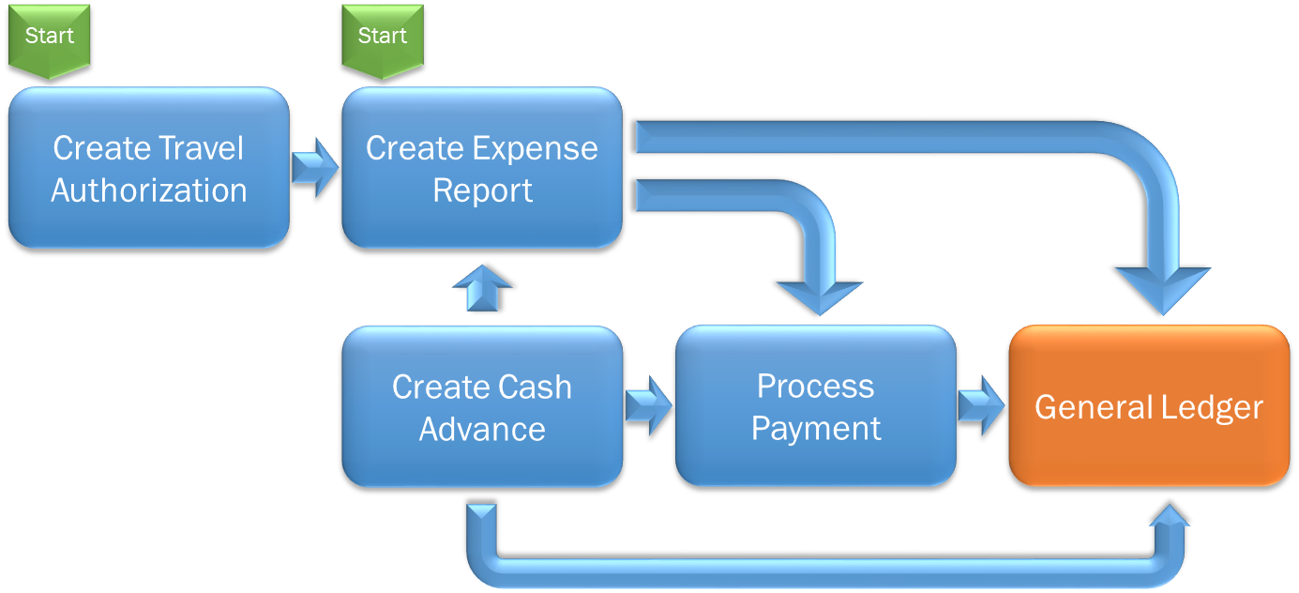

Travel & Expense Business Processes

Slide 5
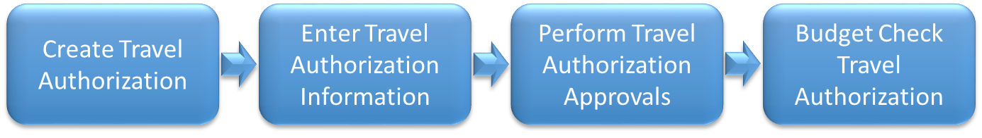
Travel Authorization (TA) Processing
A Travel Authorization only generates encumbrances via the Budget Check process identified above, and those will be based on the amounts and distributions identified in the TA line items.
Notes:
The Budget Check for a TA is performed as part of the approval process. A Travel Authorization cannot be created if the travel date has passed.

Slide 6
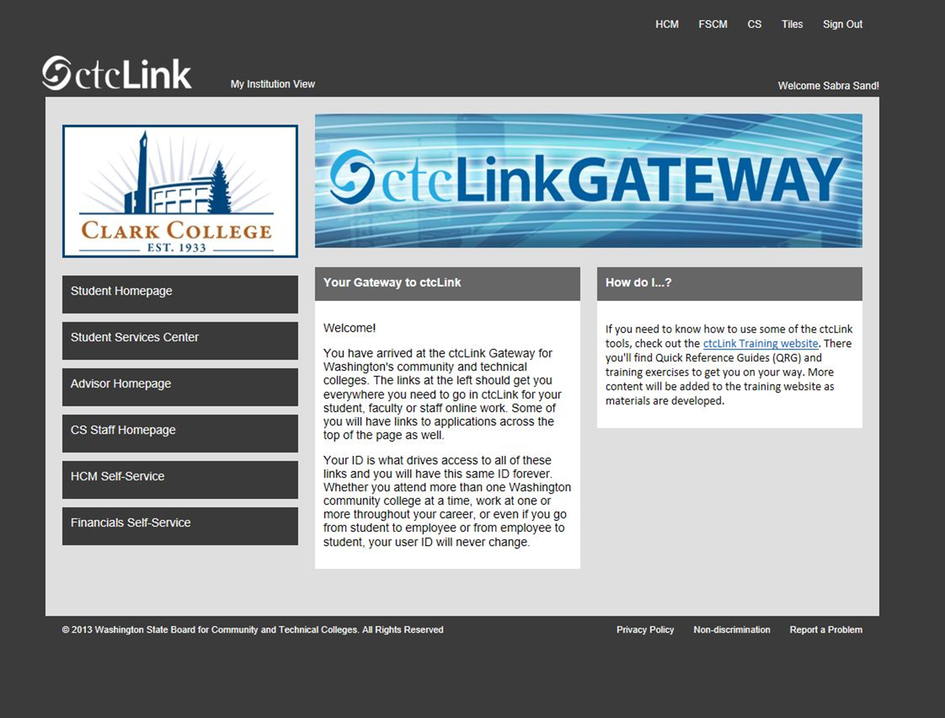

Slide 7
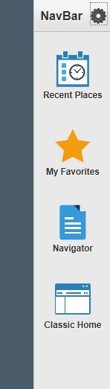
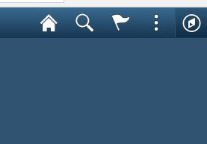
Create a New Travel Authorization
First go to Navigation (Nav Bar) on the upper right corner, click on it and it will give you a drop down menu of your options..

Slide 8
Create a New Travel Authorization
Next, select “employee self service” from your menu options
Under that selection, you will select “travel and expenses”
Then, “travel authorizations”
And, finally, “create/modify” to create a new request

Slide 9
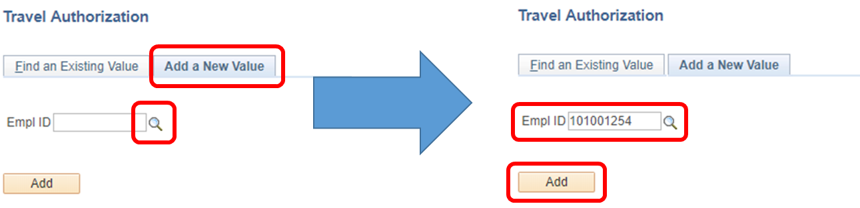
Create a New Travel Authorization
When creating any new T&E document, you will first be asked to select an Employee ID (EMPLID). This should default to your employee ID based on sign in.

Slide 10
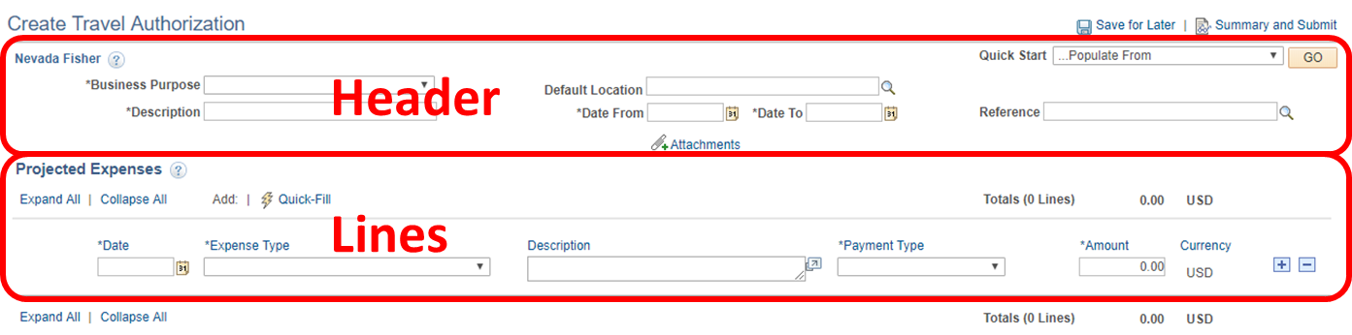
Create a New Travel Authorization
When you first create a new Travel Authorization, you will see an upper section of header fields and a lower section for “Projected Expenses” that make up the TA lines:
All required fields are denoted with an *

Slide 11
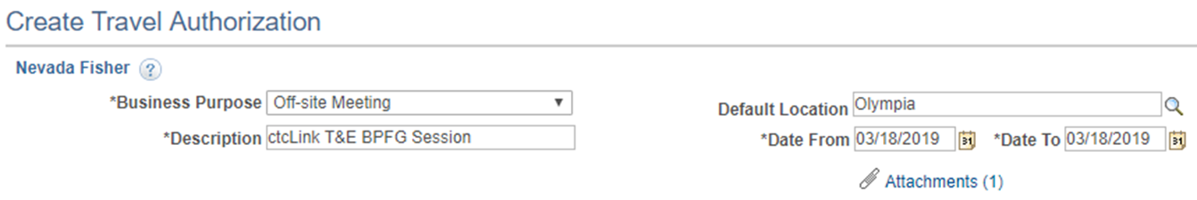
Create a New Travel Authorization
Use the travel authorization (TA) header fields to select a pre-defined Business Purpose for the TA, a free text document description, a default location (used to calculate per diem rates), and a TA date range. You can also add attachments in the header:
Remember that TAs cannot be submitted after the Date From/To dates have passed (no after-the-fact TAs).

Slide 12
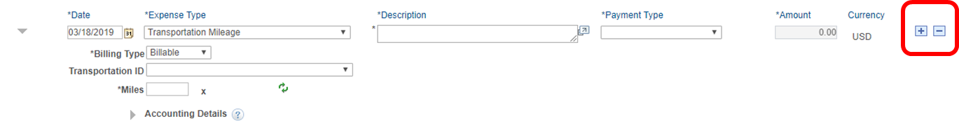
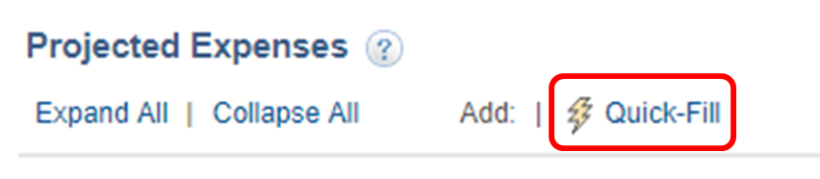
Create a New Travel Authorization
You can start working on TA lines by filling in each line item, using the plus/minus buttons to add or remove lines as you go along:
Never select prepaid as a payment type
Or you can use the Quick-Fill feature to populate multiple lines at once:

Slide 13
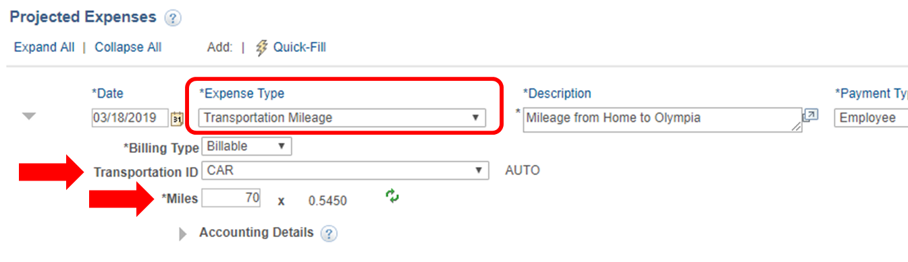
Create a New Travel Authorization
Sometimes, the fields you have available to use will change based on the Expense Type you select, bringing in new optional and/or required fields:

Slide 14
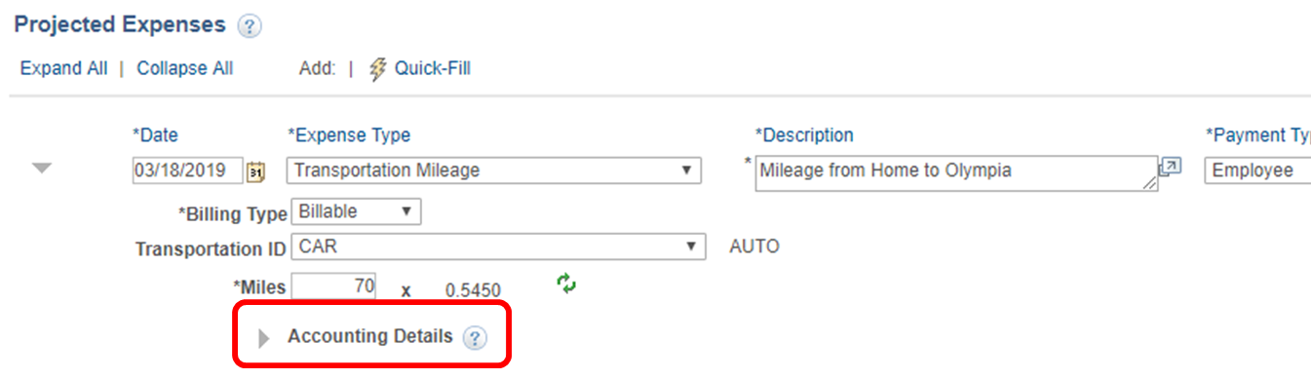
Create a New Travel Authorization
Once an Expense Type is selected for a given line, a collapsed section for “Accounting Details will also become visible. This is where a Traveler will enter/ update the funding distribution that’s intended for be used for that line:

Slide 15
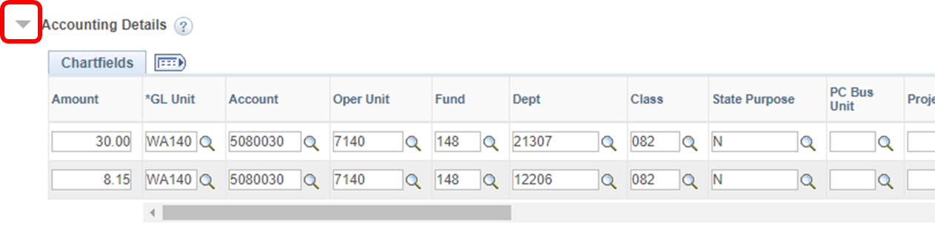
Create a New Travel Authorization
Clicking on the expand triangle will open the Chartfield block, which will already be populated with default values – you must change these values:
A single line can also be split funded any number of ways as long as the split distributions equal the overall line total.

Slide 16
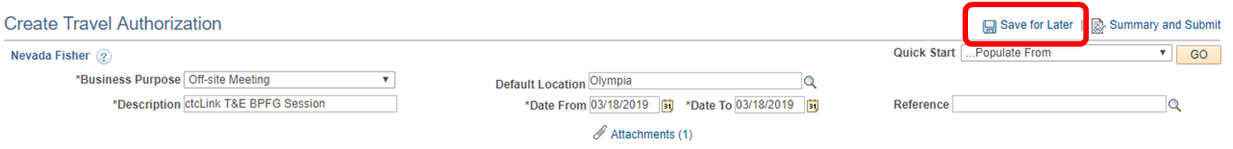
Create a New Travel Authorization
Once you have finished entering Header, Line, and Distribution information, you can save your TA by clicking on the Save for Later button:

Slide 17
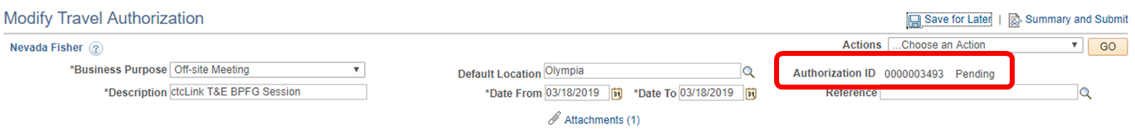
Create a New Travel Authorization
This will assign the TA an Authorization ID number and set it to a “Pending” status:

Slide 18
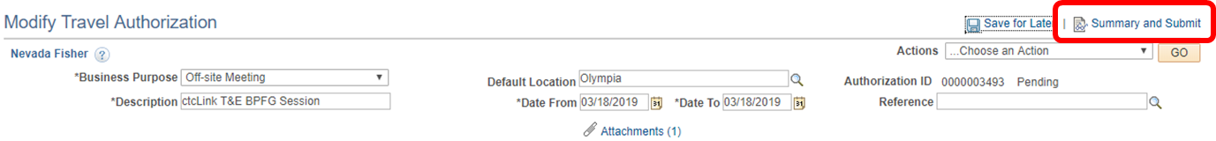
Create a New Travel Authorization
You can make changes and periodically save the TA as you are working on it, but once you are ready to submit the TA for approval you will need to click on the Summary and Submit button:
This will take you to a new page with an overview of the different line items that have been entered for the TA.

Slide 19
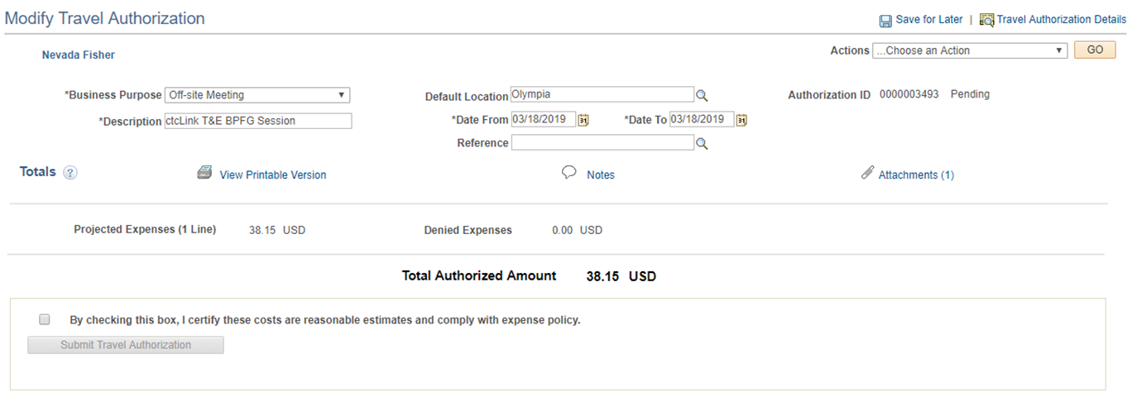
Create a New Travel Authorization
From the Summary and Submit page you can also print a copy of the TA, add text-based notes, or add/review attachments that have been added to the TA:

Slide 20
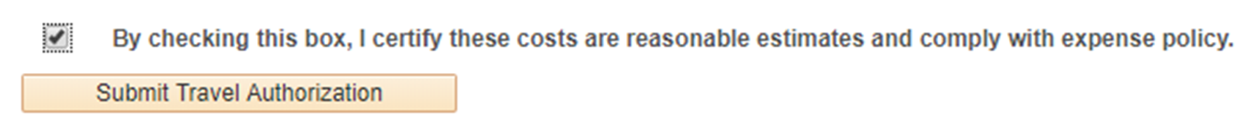
Create a New Travel Authorization
The Summary and Submit page requires the submitter to check a certification box before they can submit their TA and confirm their submittal:
Once the box is check, you are able to submit the travel authorization request

Slide 21
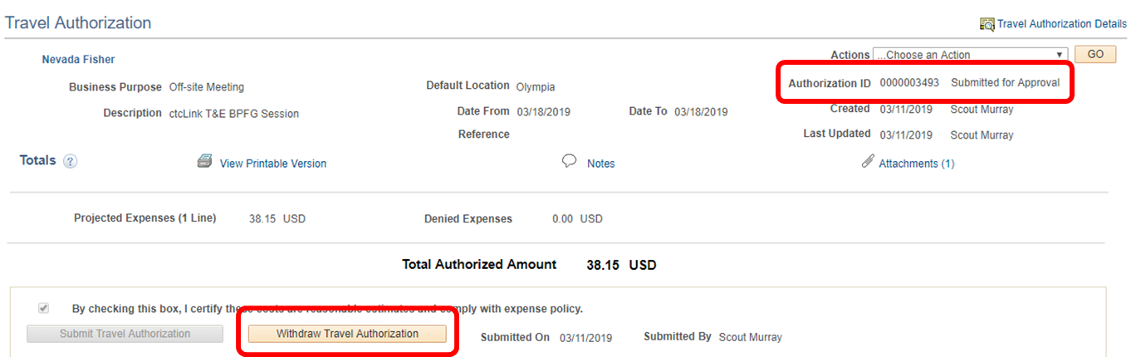
Create a New Travel Authorization
Travel Authorizations that have been successfully submitted are given a “Submitted for Approval” status. If the submittal was accidental or a needed change is recognized, the Traveler can withdraw their TA from the approval process:

Slide 22
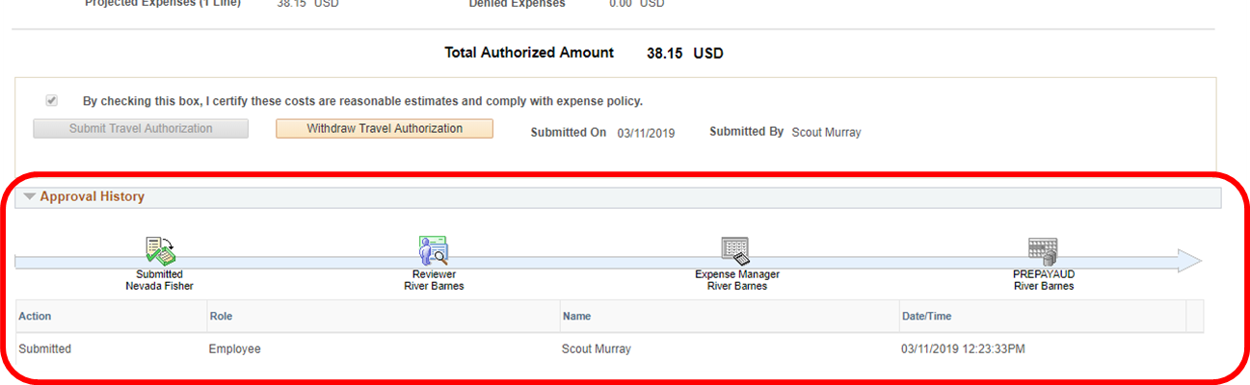
Create a New Travel Authorization
The TA Summary and Submit page will also show a graphic and log that shows where in the approval process it is and any approval history:

Slide 23
Create a New Travel Authorization
T&E approvers are able to get to the transaction specific approval page a few different ways:
  Through a link in a notification email sent to them
  Through their Worklist
  Through the T&E Approve Transactions screen
The first two options depend on whether the approver is an “Email User”, a “Worklist User”, or both. Users are both by default, and will get email notifications and be able to see pending items on their Worklist.

Slide 24
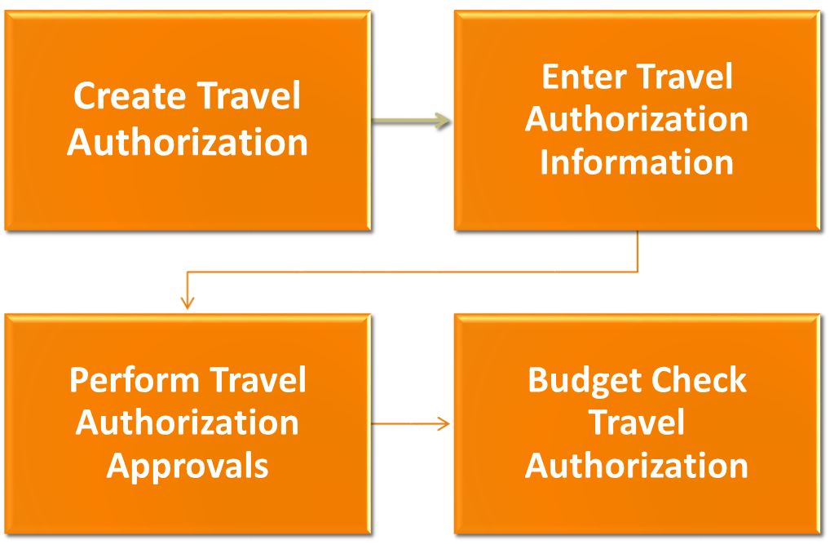

Travel authorization process

Slide 25
Approve a Travel Authorization
There are different options an Approver will have depending on how the local T&E approval process is configured:
Approve/Review – Positive action; approving/reviewing a T&E document will move it forward in the approval queue.
Deny – Negative action; denying a T&E document permanently terminates it. It cannot be resubmitted. Approver must include a comment.
Send Back – Negative action; sending a T&E document back ends the approval process but allows an authorized user to make changes to the document and/or resubmit it. Approver must include a comment.
Hold – Neutral action; holding a T&E document prevents it from being processed any further through approvals until the Approver releases it by taking a different approval action (e.g. Approve, Send Back).

Slide 26
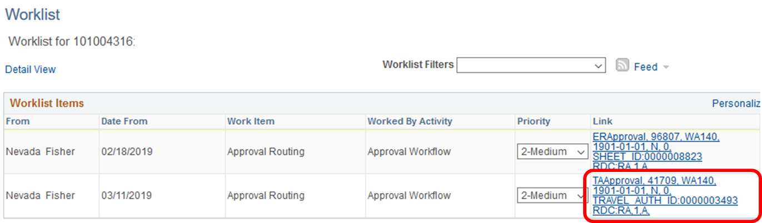
Approve a Travel Authorization
The PeopleSoft Worklist is a collection point that a user can see all of their Workflow related notifications. You can click on the Link information for a given line item to be taken to the approval page for that transaction:

Slide 27
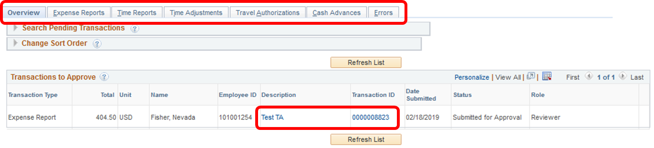
Approve aTravel Authorization
The Approve Transactions screen is good for high volume approvers. It opens to an Overview tab that shows all your pending T&E approval, and additional tabs can be used to filter to specific transaction types:

Slide 28
Approve a Travel Authorization
Regardless of the method used to select an item for approval, the TA approval page is the same. The page is divided up into several different sections:
General Information – Header information
Details – Line and Distribution information
Totals – Summary totals for the document
Pending Actions – Upcoming approval steps
Action History – Approval activity information
Comments – Approver Comment information
Actions – Where Approvers will make an approval action

Slide 29
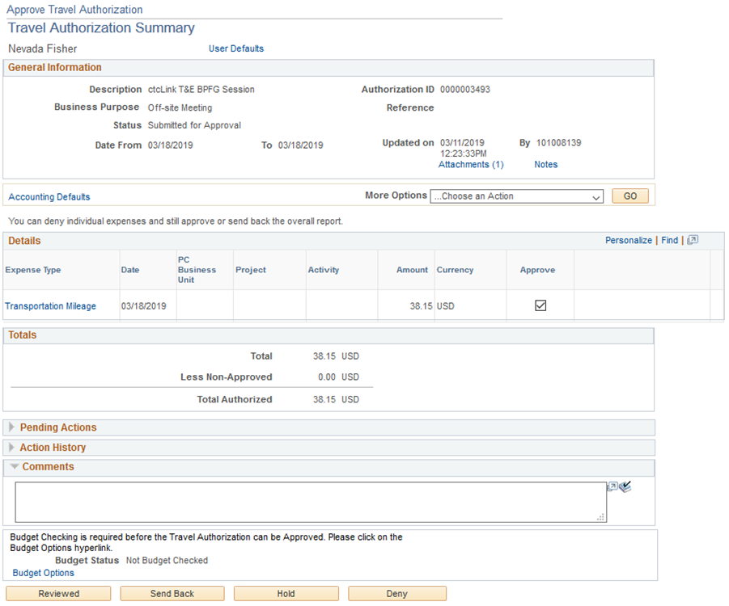
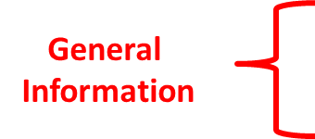



Approve a Travel Authorization

Slide 30
Create a New Travel Authorization

Slide 31
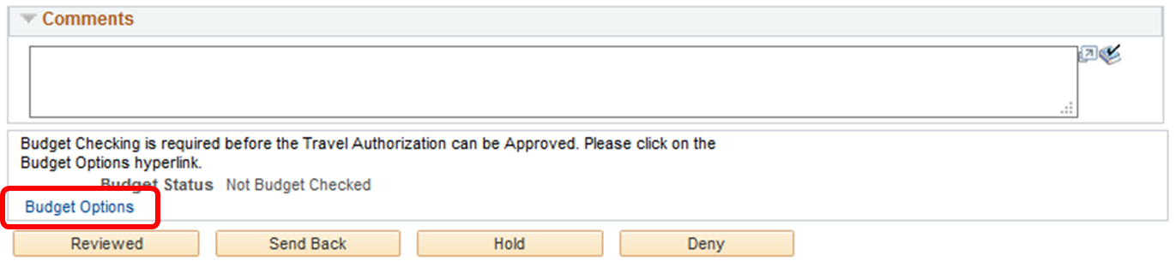
Approve a Travel Authorization
Before you can approve a transaction, you will need to run Budget Check on the transactions. To run the Budget Check from the approval screen, click on the Budget Options link text.

Slide 32
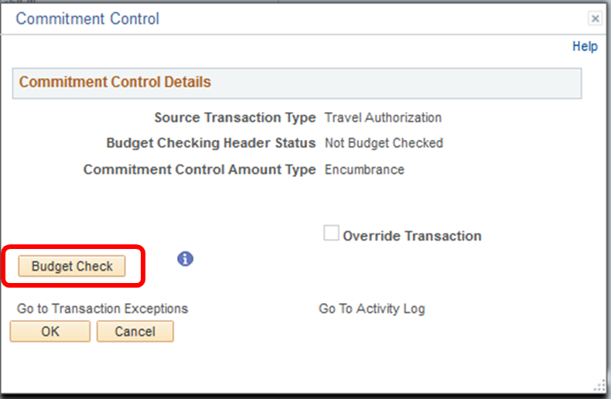
Approve a Travel Authorization
Clicking the Budget Options link text will bring up Commitment Control window. From there, click on the Budget Check button:

Slide 33
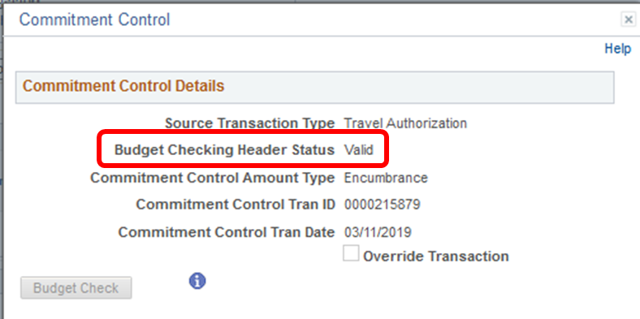
Approve a Travel Authorization
If the document passes budget checking it will return a “Valid” or “Warning” Budget Checking Header Status. If the transaction returns with an “Error” status, it will need to be sent back to the Traveler for correction or a budget adjustment will need to be made:

Slide 34
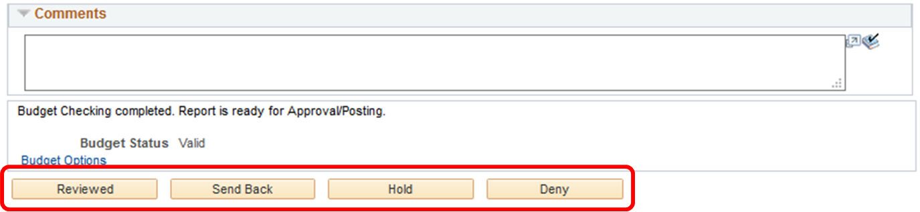
Approve a Travel Authorization
Once a document has passed budget checking, the Approver will be able to take one of their available approval actions:

Slide 35
Creating an expense report
Expense reports are created after returning from travel, either to request reimbursement for expenses, or to clear a cash advance.
An Expense Report cannot be processed prior to the identified travel dates on the document.
The navigation to create an expense report is similar to creating a travel authorization.
First go to Navigation (Nav Bar) on the upper right corner, click on it and it will give you a drop down menu of your options.. Then select “navigation”.
Next, select “employee self service” from your menu options
Under that selection, you will select “travel and expenses”
Then, “expense reports”
And, finally, “create/modify” to create a new request

Slide 36
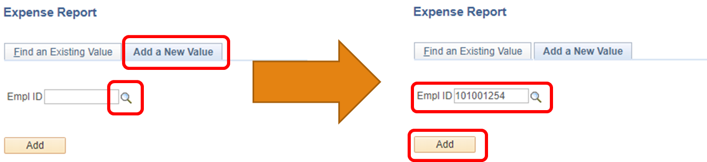
Creating an expense report
When creating any new expense report, you will first be asked to select an Employee ID (EMPLID). This should default to the user signed in.

Slide 37
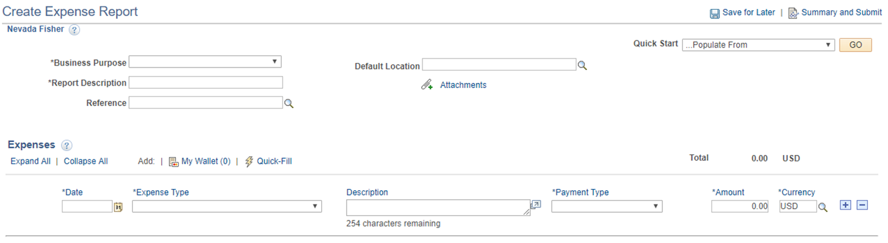
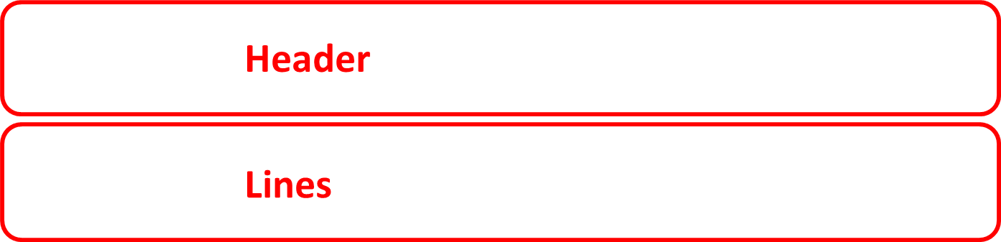
Creating an expense report
When you first create a new Expense Report, you will see an upper section of header fields and a lower section for “Expenses” that make up the ER lines:

Slide 38
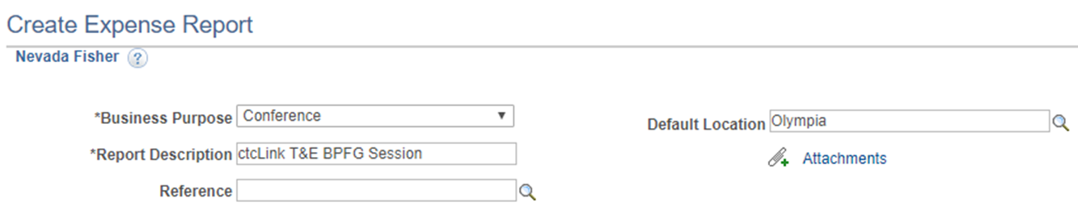
Creating an expense report
Use the ER header fields to select a pre-defined Business Purpose for the ER, a free text document description, and a default location (used to calculate per diem rates. You can also add attachments in the header:
Unlike Travel Authorizations, Expense Reports don’t have dates in the Header section. They do have individual Line item dates.

Slide 39
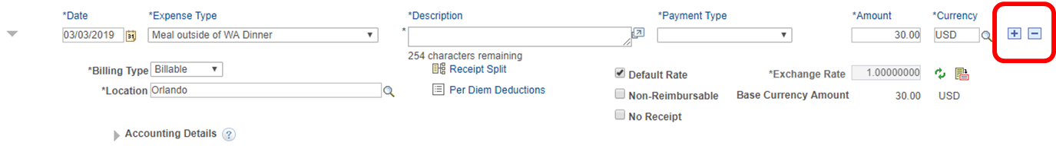
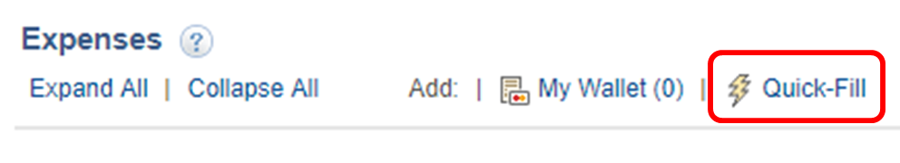
Creating an expense report
You can start working on ER lines by filling in each line item, using the plus/minus buttons to add or remove lines as you go along:
Or you can use the Quick-Fill feature to populate multiple lines at once:

Slide 40
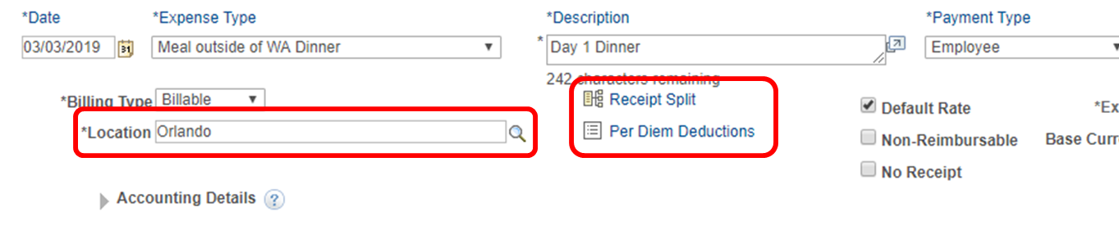
Creating an expense report
Sometimes, the fields you have available to use will change based on the Expense Type you select, bringing in new optional and/or required fields:

Slide 41
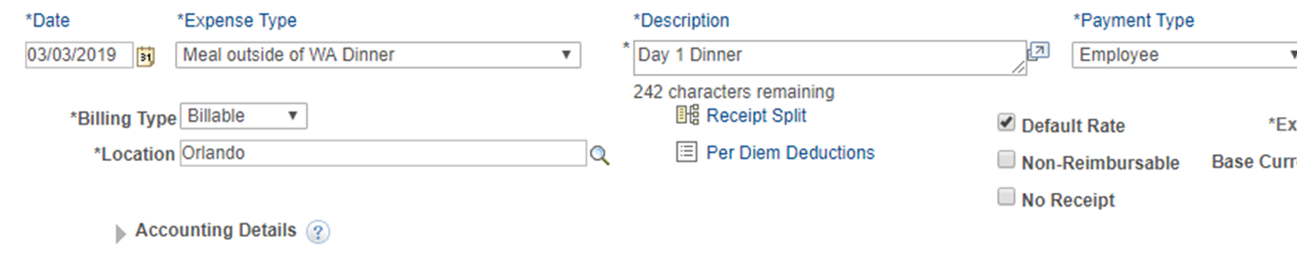
Creating an expense report
Once an Expense Type is selected for a given line, a collapsed section for “Accounting Details will also become visible. This is where a Traveler will enter/ update the funding distribution that’s intended for be used for that line:

Slide 42
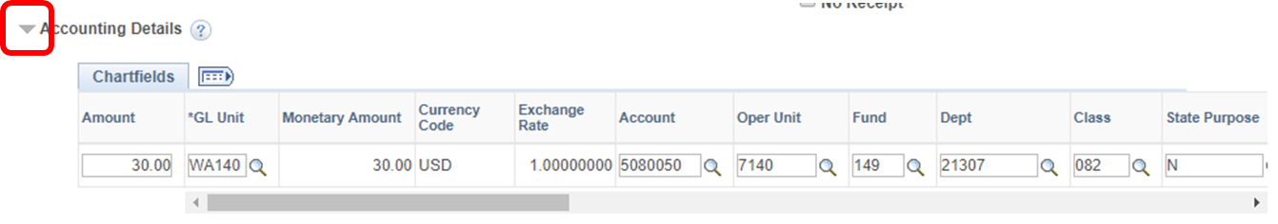
Creating an expense report
Clicking on the expand triangle will open the Chartfield block, which will already be populated with default values, you must change these values:

Slide 43
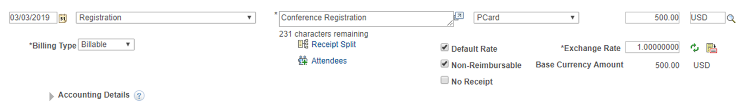

Creating an expense report
Expense Reports are unique in that line items can be flagged as “Non-Reimbursable”. Using this feature for line items like registration or airfare that are paid for by a PCard allows them to be included to show the total cost of travel without impacting any true reimbursements due to the Traveler:

Slide 44
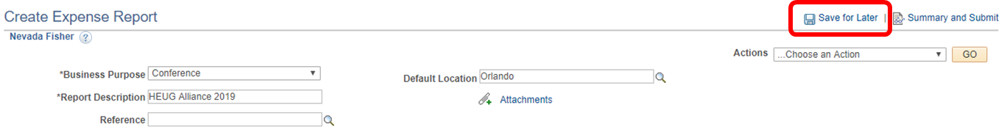
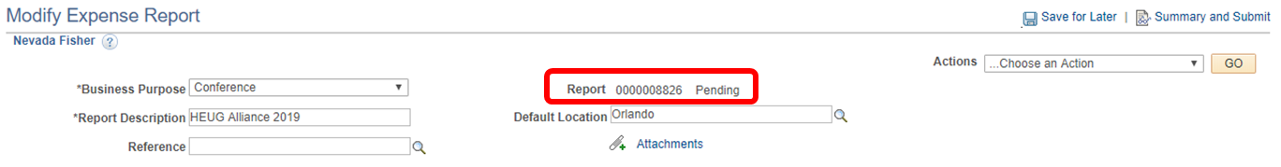
Creating an expense report
Once you have finished entering Header, Line, and Distribution information, you can save your ER by clicking on the Save for Later button:
This will assign the ER a Report ID number and set it to a “Pending” status:

Slide 45
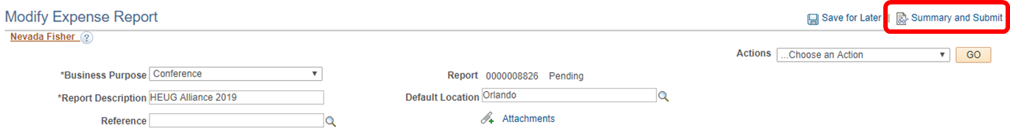
Creating an expense report
You can make changes and periodically save the ER as you are working on it, but once you are ready to submit the ER for approval you will need to click on the Summary and Submit button:
This will take you to a new page with an overview of the different line items that have been entered for the ER.

Slide 46
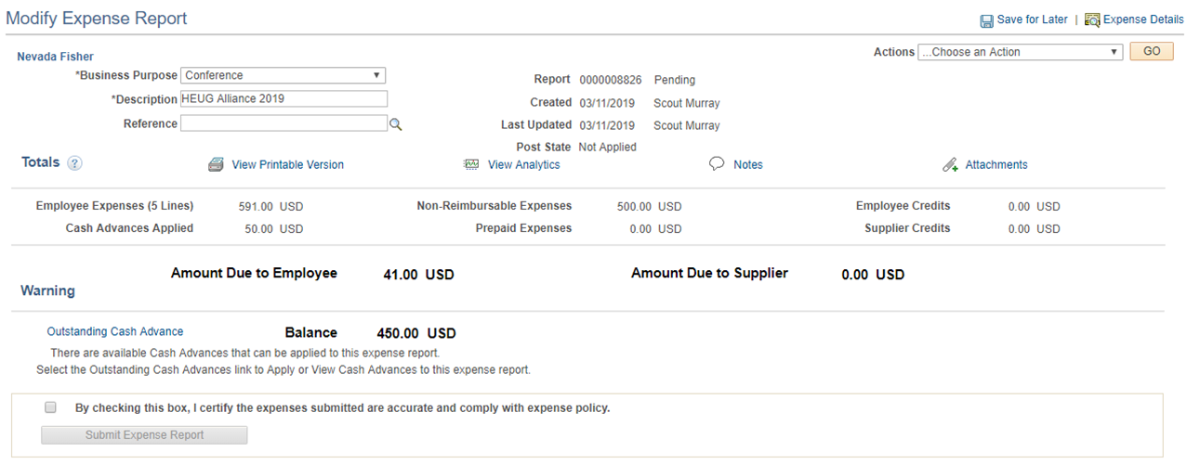
Submitting an expense report
From the Summary and Submit page you can also print a copy of the ER, add text-based notes, or add/review attachments that have been added to the ER:

Slide 47
Submitting an expense report
The Summary and Submit page requires the submitter to check a certification box before they can submit their ER and confirm their submittal:
You must check the box before you are able to submit the expense report.

Slide 48
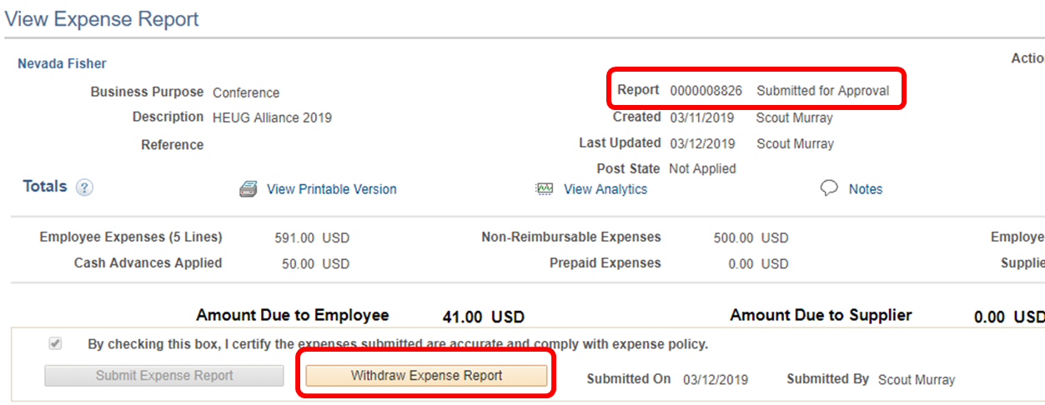
Submitting an expense report
Expense Reports that have been successfully submitted are given a “Submitted for Approval” status. If the submittal was accidental or a needed change is recognized, the Traveler can withdraw their ER from the approval process:

Slide 49
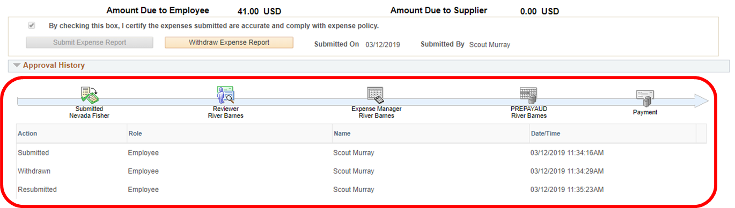
Submitting an expense report
The ER Summary and Submit page will also show a graphic and log that shows where in the approval process it is and any approval history:

Slide 50
Approving an expense report
T&E approvers are able to get to the transaction specific approval page a few different ways:
  Through a link in a notification email sent to them
  Through their Worklist
  Through the T&E Approve Transactions screen
The first two options depend on whether the approver is an “Email User”, a “Worklist User”, or both. Users are both by default, and will get email notifications and be able to see pending items on their Worklist.

Slide 51
Approving an expense report
There are different options an Approver will have depending on how the local T&E approval process is configured:
Approve/Review – Positive action; approving/reviewing a T&E document will move it forward in the approval queue.
Deny – Negative action; denying a T&E document permanently terminates it. It cannot be resubmitted. Approver must include a comment.
Send Back – Negative action; sending a T&E document back ends the approval process but allows an authorized user to make changes to the document and/or resubmit it. Approver must include a comment.
Hold – Neutral action; holding a T&E document prevents it from being processed any further through approvals until the Approver releases it by taking a different approval action (e.g. Approve, Send Back).

Slide 52
Approving an expense report
Regardless of the method used to select an item for approval, the ER approval page is the same. The page is divided up into several different sections:
General Information – Header information
Totals – Summary totals for the document
Approval History – Approval activity information
Comments – Approver Comment information
Actions – Where Approvers will make an approval action
Receipt Information – Only used with Receipt Verification
Expense Line – Line info and links to Distribution info

Slide 53
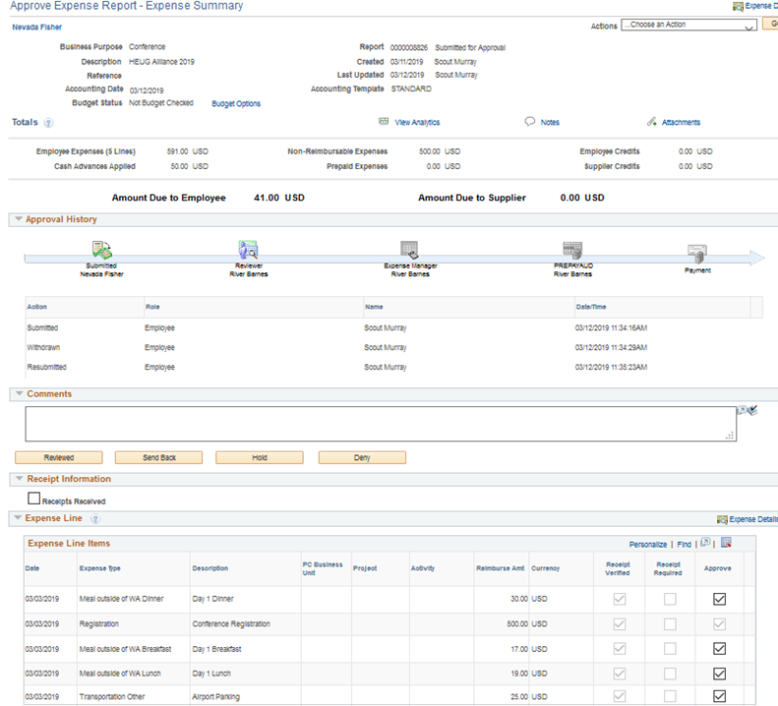
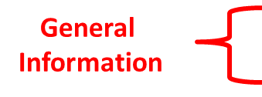

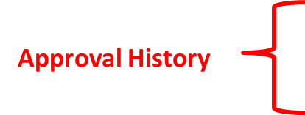
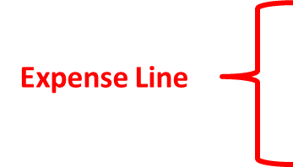
Approving an expense report

Slide 54
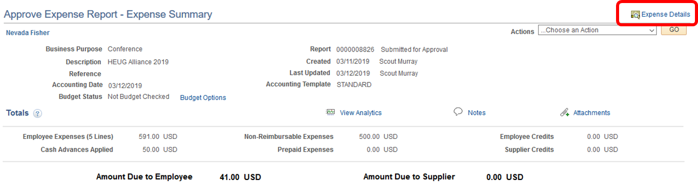
Approving an expense report
The Expense Report approval page is a little different from the one for Travel Authorization in terms of how you get to line item details. This can be done by clicking on one of the “Expense Details” links on the screen:

Slide 55

Approving an expense report
The line items on the Expense Details page can be expanded to see additional line and distribution information:

Slide 56

Budget checking an expense report
Before you can make an approval action you will need to run budget checking. To run the Budget Check from the approval screen, click on the Budget Options link text.

Slide 57

Budget chekcing an expense report
Clicking the Budget Options link text will bring up Commitment Control window. From there, click on the Budget Check button:

Slide 58

Budget chekcing an expense report
If the document passes budget checking it will return a “Valid” or “Warning” Budget Checking Header Status. If the transaction returns with an “Error” status, it will need to be sent back to the Traveler for correction or a budget adjustment will need to be made:

Slide 59

Budget checking an expense report
Once a document has passed budget checking, the Approver will be able to take one of their available approval actions:

Slide 60
Questions?

